Slide 1
UFCFVK-15-2 Internet of Things
Bluetooth

Slide 2
Bluetooth Low Energy (4.x and 5.0)
Hardware perspecive

Slide 4
Short range wireless application areas
 | Voice | Data | Audio | Video | State
Bluetooth Asynchronous Connection Less / High Speed | x | Y | Y | x | x
Bluetooth Synchronous Connection Oriented /enhanced SCO | Y | x | x | x | x
Bluetooth low energy | x | x | x | x | Y
Wi-Fi | (VoIP) | Y | Y | Y | x
Wi-Fi Direct | Y | Y | Y | x | x
ZigBee | x | x | x | x | Y
ANT | x | x | x | x | Y
Low Power
State = low bandwidth, low latency data

Slide 5
Zigbee devices can transmit data over long distances by passing data through a mesh network of intermediate devices to reach more distant ones. Zigbee is typically used in low data rate applications that require long battery life and secure networking.
Advanced and Adaptive Network Technology,” which is a low-energy wireless protocol meant to collect and transfer sensor data
Worldwide 2.4GHz ISM band operation
Ideal for sports and fitness devices
Very easy-to-use
Advanced networking capabilities

Slide 6
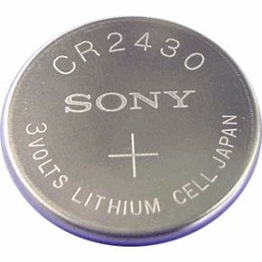
What is Bluetooth LE
Bluetooth low energy is a NEW, open, short range radio technology
Different to Bluetooth classic (BR/EDR)
Basic Rate/Enhanced Data Rate (BR/EDR), is a low power radio that streams data over 79 channels in the 2.4GHz unlicensed industrial, scientific, and medical (ISM) frequency band
Optimized for ultra low power
Enable coin cell battery use cases
< 20mA peak current
< 5 uA average current

Slide 7
Basic Concepts of Bluetooth LE
Everything is optimized for lowest power consumption
Short packets reduce TX peak current
Short packets reduce RX time
Less RF channels to improve discovery and connection time
Simple state machine
Single protocol
And so on.

Slide 8
Bluetooth low energy factsheet 1
Range: | ~ 150 meters open field (1000 for BLE 5.x)
Output Power: | ~ 10 mW (10dBm)
Max Current: | ~ 15 mA
Latency: | 3 ms speed
Topology: | Star
Connections: | > 2 billion
Modulation: | GFSK @ 2.4 GHz
Robustness: | Adaptive Frequency Hopping, 24 bit CRC
Security: | 128bit AES CCM
Sleep current: | ~ 1μA
Modes: | Broadcast, Connection, Event Data Models, Reads, Writes

Slide 9
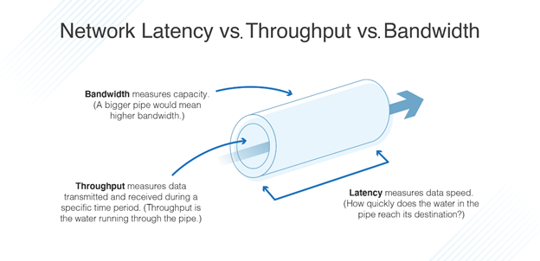
Latency measures delay. Delay is simply the time taken for a data packet to reach its destination after being sent. We measure network latency as round trips, although it may sometimes be measured in one-way trips.

Slide 10
Bluetooth low energy factsheet 3
Data Throughput
For Bluetooth low energy, data throughput is not a meaningful parameter. It does not support streaming.
It has a data rate of 1Mbps, but is not optimized for file transfer.
It is designed for sending small chunks of data (exposing state)

Slide 11
Designed for exposing state
23.2˚C
60.5 km/h
12:23 pm
It’s good at small, discrete data transfers.
Data can triggered by local events.
Data can be read at any time by a client.
Interface model is very simple (GATT)
A GATT service is a collection of characteristics.
For example, the heart rate service contains a heart rate measurement characteristic and a body location characteristic, among others. Multiple services can be grouped together to form a profile.
Gate 10 BOARDING
3.2 kWh
PLAY >>
Network Available

Slide 12
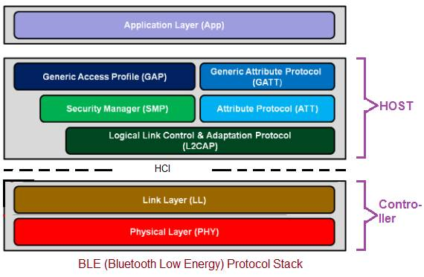
Bluetooth Low Energy Architecture

Slide 13
Physical Layer :
• The transmitter uses GFSK modulation and operates at unlicensed 2.4 GHz frequency band. • Using this PHY layer, BLE offers data rates of 1 Mbps (Bluetooth v4.2)/2 Mbps (Bluetooth v5.0). • It uses frequency hopping transceiver.
• Link Layer :
This layer sits above the Physical layer. It is responsible for advertising, scanning, and creating/maintaining connections.

Slide 14
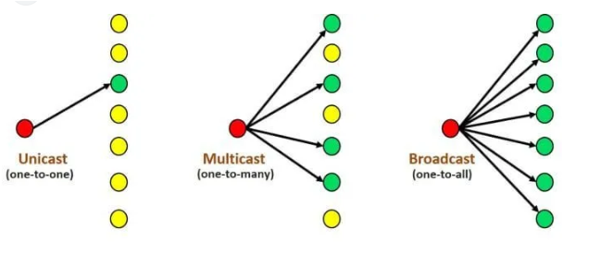

Slide 15
SMP :This security Manager layer provides methods for device pairing and key distributions. It offers services to other protocol stack layers in order to securely connect and exchange data between BLE devices. • GAP : This layer directly interfaces with application layer and/or profiles on it. It handles device discovery and connection related services for BLE device. It also takes care of initiation of security features. • GATT : This layer is service framework which specifies sub-procedures to use ATT. Data communications between two BLE devices are handled through these sub-procedures. The applications and/or profiles will use GATT directly. • ATT : This layer allows BLE device to expose certain pieces of data or attributes.

Slide 16
Device Modes
Dual Mode
Bluetooth BR/EDR and BLE
Used anywhere that BR/EDR is used today
Single Mode
Implements only Bluetooth LE
Used in newer devices / applications

Slide 17
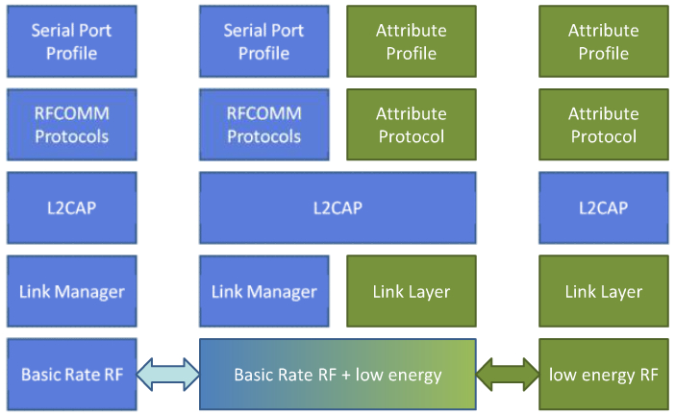
Device Modes
Dual mode + single modes
BR/EDR stack
Dual-mode stack
Single-mode stack

Slide 18
Serial Port Profile defines the protocols and procedures that shall be used by devices using Bluetooth for RS232 (or similar) serial cable emulation.
The Bluetooth protocol RFCOMM is a simple set of transport protocols, made on top of the L2CAP protocol, providing emulated RS-232 serial ports (up to sixty simultaneous connections to a Bluetooth device at a time)
L2CAP is used within the Bluetooth protocol stack. It passes packets to either the Host Controller Interface (HCI) or, on a hostless system, directly to the Link Manager/ACL link.
L2CAP's functions include: Multiplexing data between different higher layer protocols.
LMP establishes logical links between Bluetooth devices and maintains the links for enabling communications

Slide 19
The Link layer is the second lowest protocol in the Bluetooth Low Energy protocol stack.
It’s responsible for managing the state of the LE radio, among other things.
To do this, the Link layer relies on a state machine.
So, what’s a state machine? In short, it’s a model that defines how a system should behave under certain conditions.

Slide 20
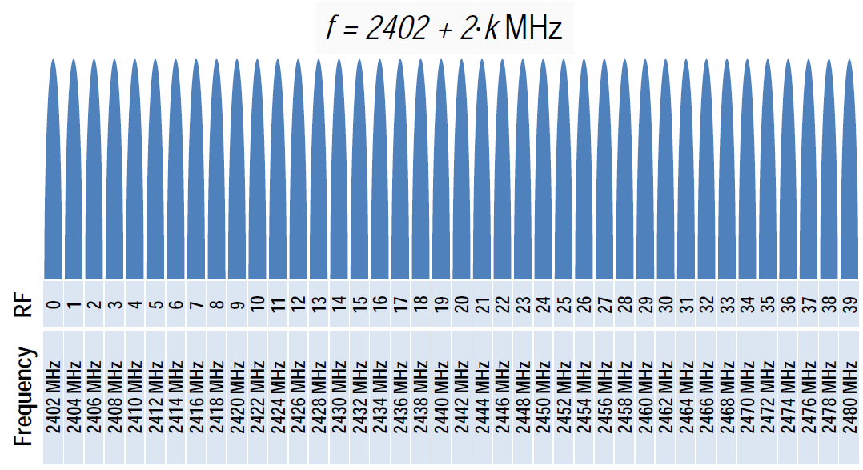
Physical Layer
2.4 GHz ISM band
1Mbps GFSK
Larger modulation index than Bluetooth BR (which means better range)
40 Channels on 2 MHz spacing

Slide 21
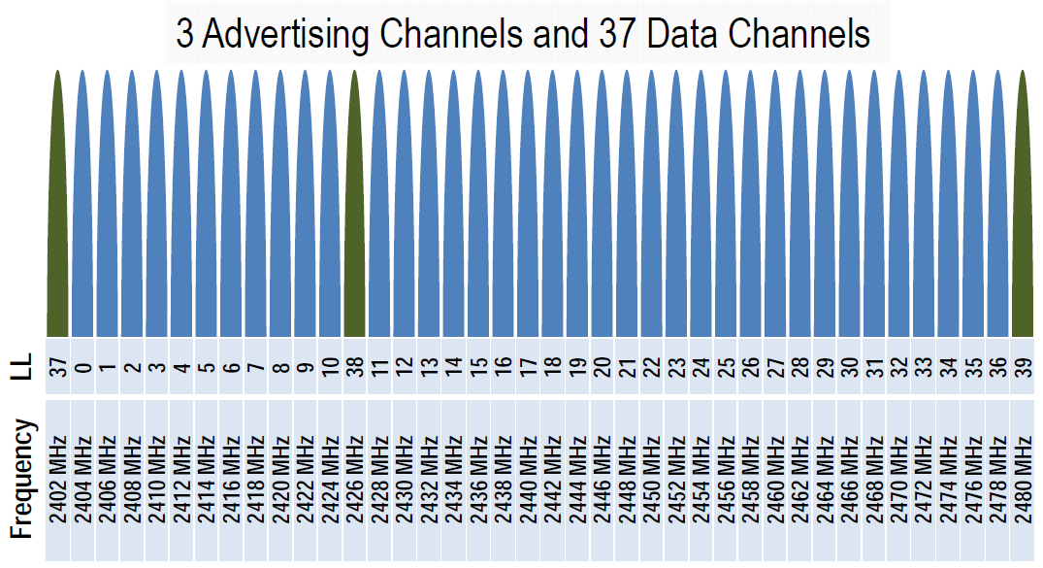
Physical Channels
Two types of channels

Slide 22
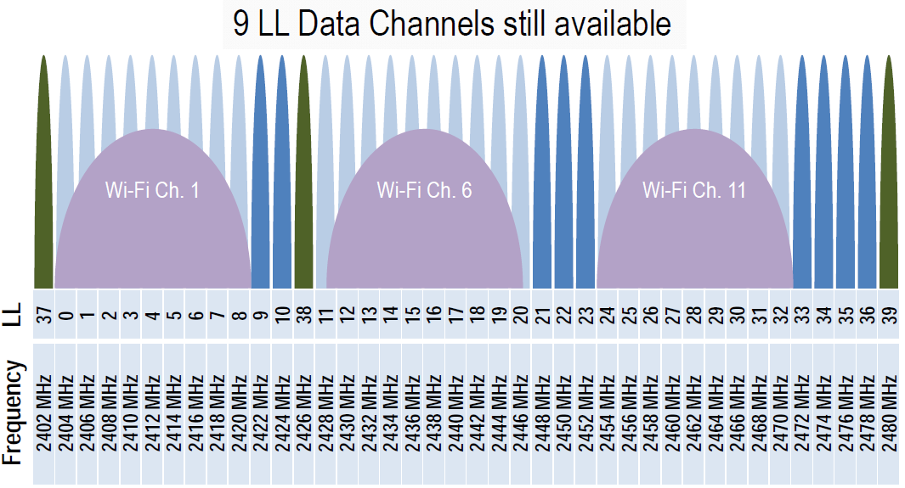
Physical Channels
Advertising channels avoid 802.11

Slide 23
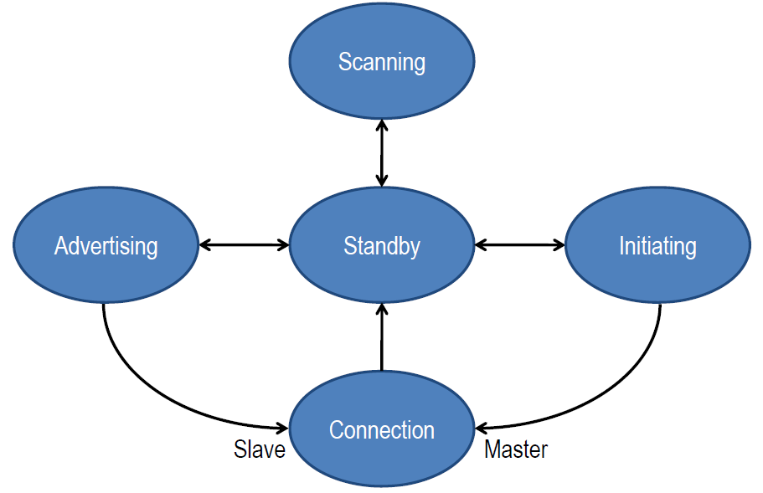
Link Layer
Link Layer state machine

Slide 24
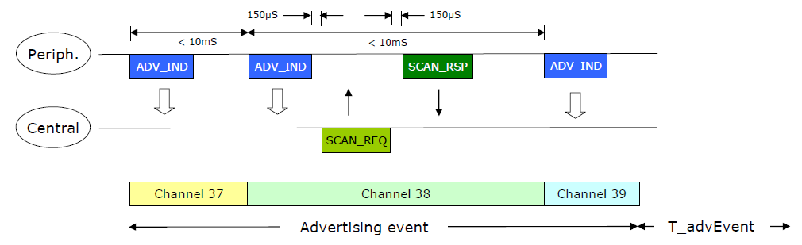
Advertising
Devices can advertise for a variety of reasons:
To broadcast
To transmit signed data to a previously bonded device
To advertise their presence to a device wanting to connect
To reconnect asynchronously due to a local event

Slide 25
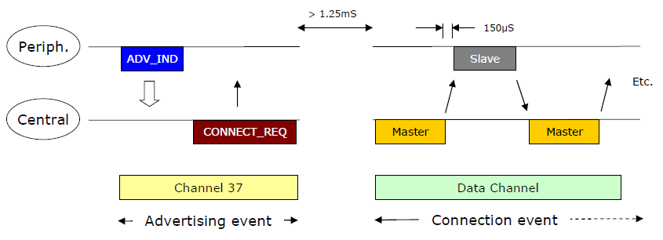
Data transactions
Once a connection is made:
Master informs slave of hopping sequence and when to wake
All subsequent transactions are performed in the 37 data channels
Transactions can be encrypted
Both devices can go into deep sleep between transactions

Slide 26
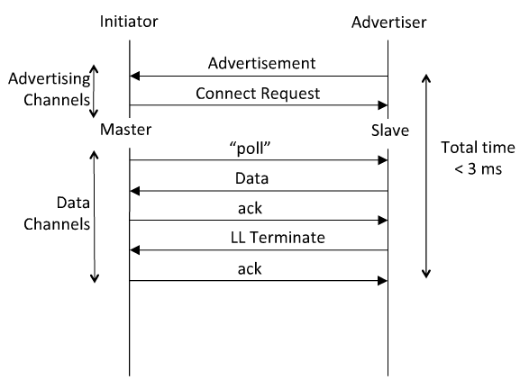
Link Layer Connection
Very low latency connection
Central

Slide 27
Thank you

